Slide 1
声音能传递信息和能量
版本：教育科学出版社
姓名：李浩宇
单位：湘乡市梅桥中心校
邮编：411408
电话：13873258218

Slide 2



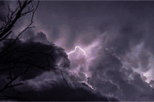
声音可以传递
信息

Slide 3
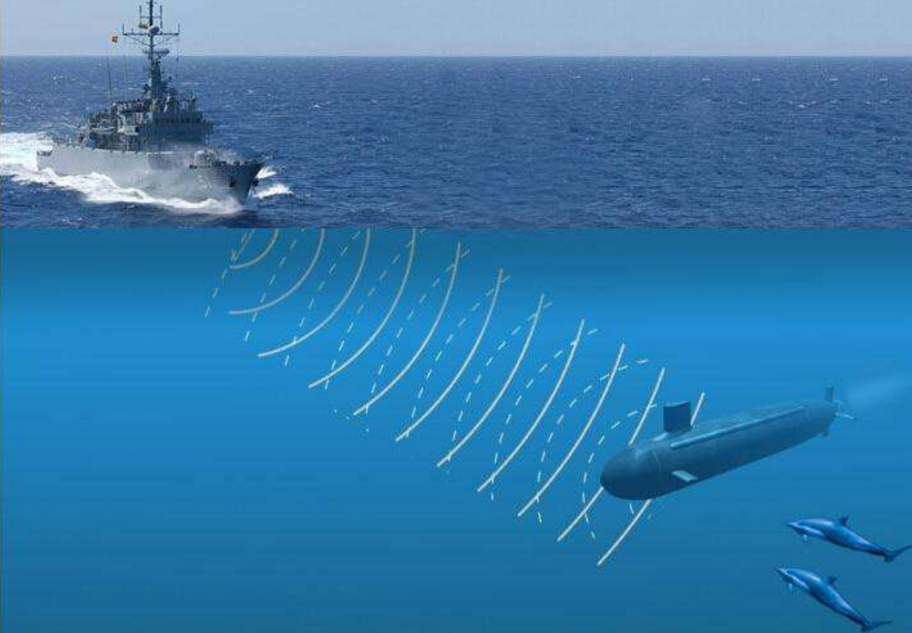
6
声呐原理：声学定位
超声波遇到障碍物会反射
接收到反射回来的超声波就可以定位物体
潜艇的位置

Slide 4
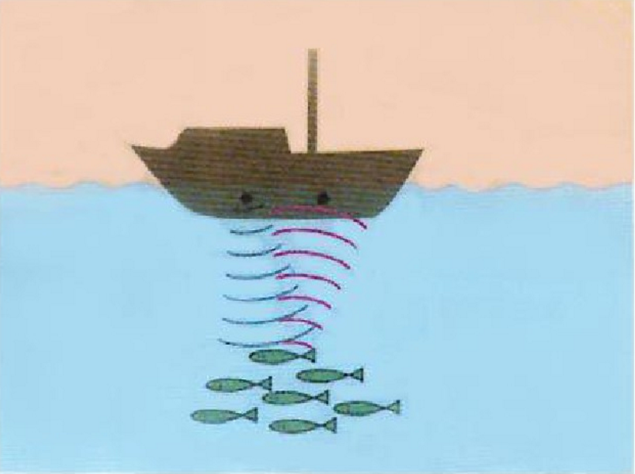
鱼群的位置

Slide 5
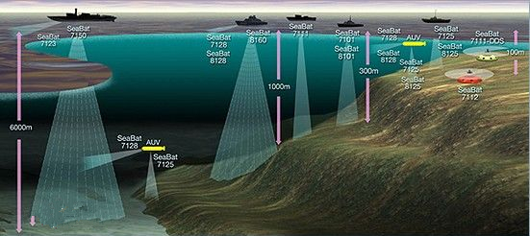
海底的深度

Slide 6
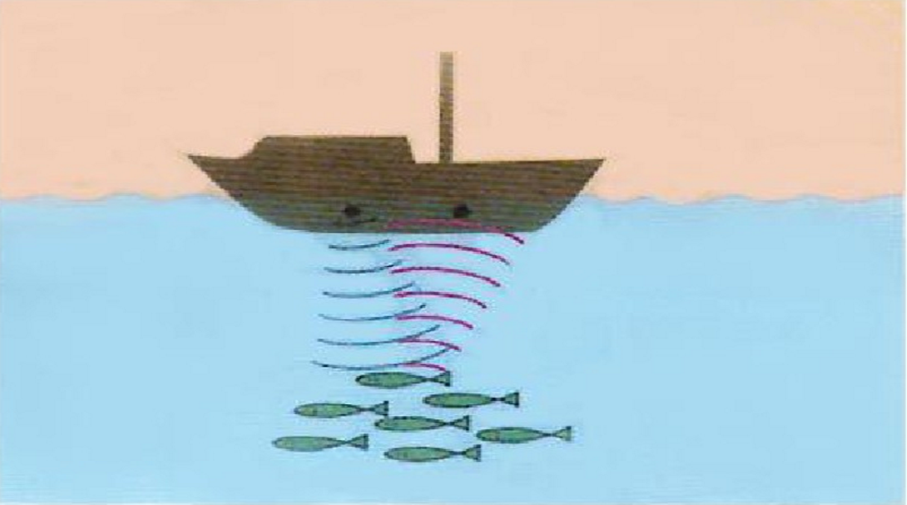

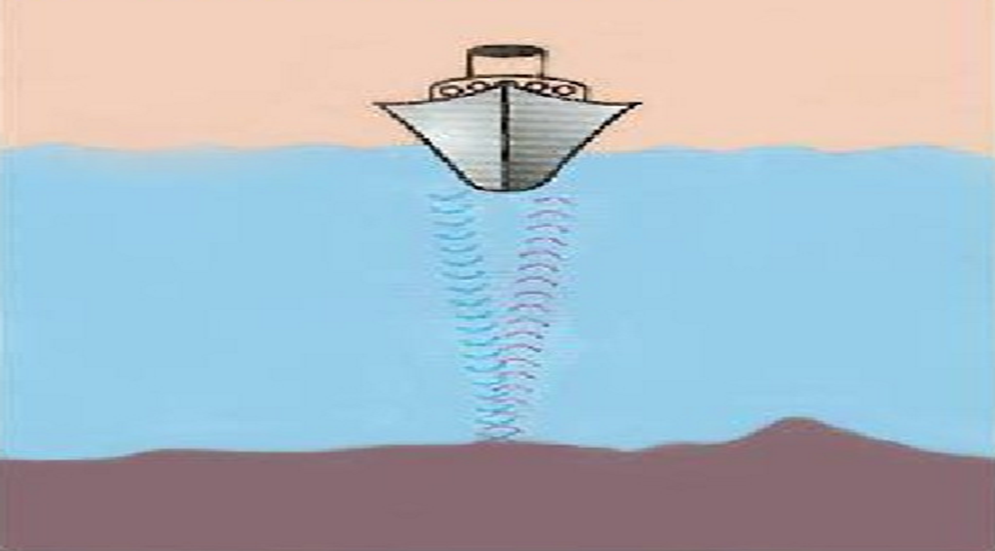
声呐：传递了物体的位置 信息

Slide 7


Slide 8
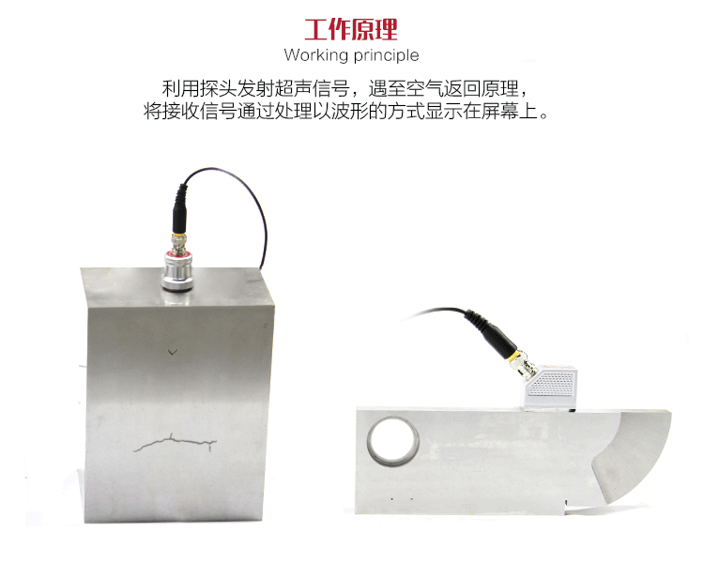

Slide 9
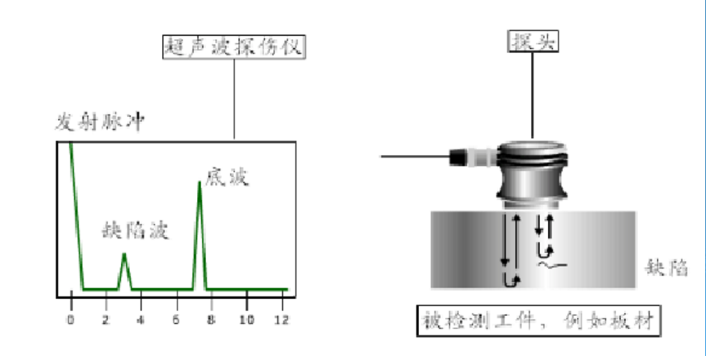

Slide 10
超声波探伤仪：传递了物体内部的结构 信息

Slide 11
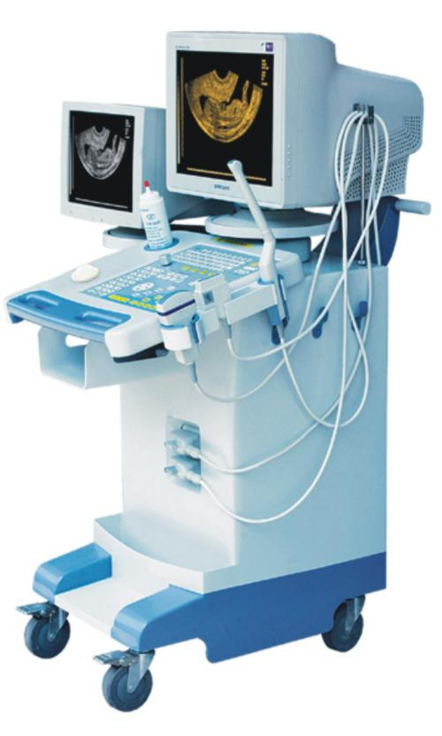
超声波检查仪

Slide 12
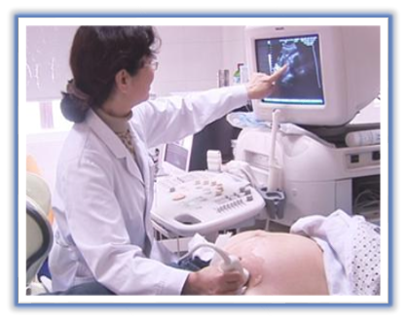
超声波检查

Slide 13
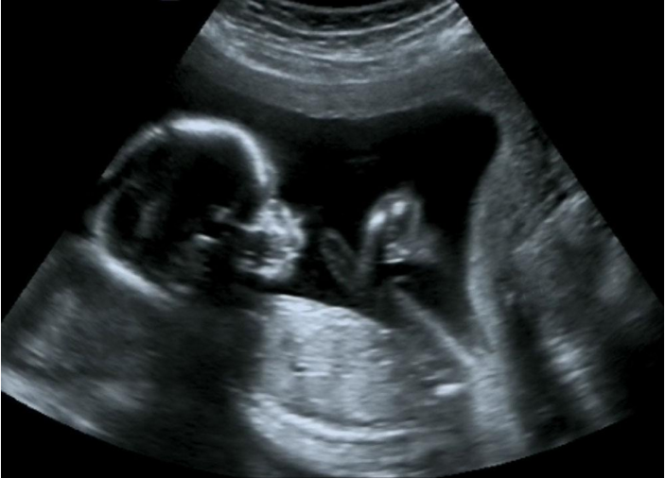
胎儿超声波图像

Slide 14
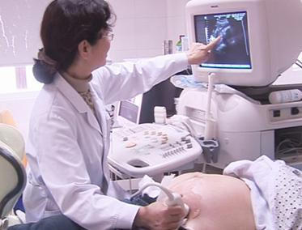
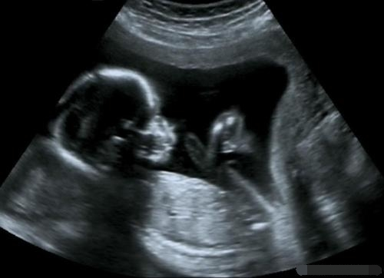
超生波检查：传递了健康 信息
Notes:
Animated multiple successive images in a picture show
(Basic)
To reproduce the picture effects on this slide, do the following:
On the Home tab, in the Slides group, click Layout, and then click Blank.
On the Home tab, in the Drawing group, click Shapes, and then under Rectangles click Rectangle (first option from the left). On the slide, drag to draw a rectangle.
Select the rectangle. Under Drawing Tools, on the Format tab, in the Size group, do the following:
In the Shape Height box, enter 4.55”.
In the Shape Width box, enter 8”.
On the Home tab, in the bottom corner of the Drawing group, click the Format Shape dialog box launcher. In the Format Shape dialog box, in the left pane, click Fill. In the Fill pane, click Solid fill. Click the button next to Color, and then under Theme Colors click Black, Text 1 (top row, second option from the left).
Also in the Format Shape dialog box, in the left pane, click Line Color. In the Line Color pane, click Solid line, click the button next to Color, and then under Theme Colors click Black, Text 1, Lighter 35% (third row, second option from the left).
Also in the Format Shape dialog box, in the left pane, click Line Style, and then do the following in the Line Style pane:
In the Width box, enter 20 pt.
In the Cap type list, select Flat.
In the Join type list, select Miter.
Also in the Format Shape dialog box, in the left pane, click Shadow. In the Shadow pane, click the button next to Presets, and then under Perspective click Perspective Diagonal Upper Right (first row, second option from the left).
Also in the Format Shape dialog box, in the left pane, click 3-D Format, and then do the following in the 3-D Format pane:
Under Bevel, click the button next to Top, and then under Bevel click Hard Edge (third row, third option from the left). Next to Top, in the Width box, enter 27 pt, and in the Height box, enter 5.5 pt.
Under Depth, click the button next to Color, and then under Theme Colors click Black, Text 1, Lighter 35% (third row, second option from the left). In the Depth box, enter 40 pt.
Also in the Format Shape dialog box, in the left pane, click 3-D Rotation, and then do the following in the 3-D Rotation pane:
Click the button next to Presets, and then under Perspective, click Perspective Contrasting Left (second row, fourth option from the left).
In the X box, enter 20⁰.
In the Y box, enter 9.3⁰.
In the Z box, enter 358⁰.
In the Perspective box, enter 45⁰.
Click Close to close the dialog box.
On the slide, drag the rectangle slightly to the left to position it in the middle of the slide.
On the Insert tab, in the Images group, click Picture. In the Insert Picture dialog box, select a picture, and then click Insert.
On the slide, select the picture. Under Picture Tools, on the Format tab, in the bottom right corner of the Size group, click the Size and Position dialog box launcher. In the Size and Position dialog box, on the Size tab, resize or crop the picture as needed so that under Size and rotate, the Height box is set to 4.11” and the Width box is set to 7.3”. Crop the picture on the Crop tab by entering values into the boxes under Picture Position and Crop Position.
Under Drawing Tools, on the Format tab, in the Picture Styles group, click the arrow next to Picture Border, and then do the following:
Under Theme Colors click Black, Text 1 (first row, second option from the left).
Point to Weight, and then click 3 pt.
Under Picture Tools, on the Format tab, in the bottom right corner of the Picture Styles group, click the Format Shape dialog box launcher. In the Format Picture dialog box, in the left pane, click 3-D Rotation, and then do the following in the 3-D Rotation pane:
Click the button next to Presets, and then under Perspective click Perspective Contrasting Left (second row, fourth option from the left).
In the X box, enter 20⁰.
In the Y box, enter 9.3⁰.
In the Z box, enter 358⁰.
In the Perspective box, enter 45⁰.
Select the picture. On the Home tab, in the Clipboard group, click the arrow under Paste, and then click Duplicate. Repeat this process one more time for a total of three pictures.
NOTE: You can do this procedure with as many pictures as you want. This article uses three for purposes of demonstration.
Select the second picture and repeat steps 12-14. Do this for each picture that you have added.
Press and hold CTRL, and then select all three pictures on the slide. On the Home tab, in the Drawing group, click Arrange, point to Align, and repeat to do each of the following:
Click Align Slide.
Click Align Middle.
Click Align Center.
Drag the group of three pictures into the middle of the rectangle (picture frame).
TIP: You might find it easiest to position the pictures precisely in the frame rectangle by selecting a picture, holding down the CTRL key and using the keyboard direction arrows.
To reproduce the animation effects on this slide, do the following:
On the Home tab, in the Editing group, click Select, and then click Selection Pane.
On the Animations tab, in the Animation group, click Animation Pane.
In the Selection and Visibility pane, select the first picture and do the following:
On the Animations tab, in the Advanced Animation group, click Add Animation, then under Exit, click Fade, and then click OK.
In the Animation Pane, click the arrow at the picture’s animation effect and click Timing, then in the Fade dialog box, do the following:
In the Start box, click After Previous.
In the Delay box, enter 0.5.
In the Duration box, click 2 seconds (Medium).
Repeat steps 1 through 3 for the other pictures.
TIP: If all pictures are assigned the Exit animation, the ending image on the slide will be blank. To prevent this, do not assign the Exit animation effect to the final picture.
To reproduce the background effects on this slide, do the following:
Right-click the slide background area, and then click Format Background.
In the Format Background dialog box, on the Fill tab, do the following:
Select Gradient fill.
In the Type list, select Linear.
Click the button next to Direction, and then click Linear Up (second row, second option from the left).
Under Gradient stops, click Add or Remove until two stops appear on the slider.
Select a stop on the slider, and then do the following:
In the Stop position box, enter 0%.
Click the button next to Color, and then under Theme Colors click White, Background 1, Darker 35% (fifth row, first option from the left).
Select the other stop on the slider, and then do the following:
In the Stop position box, enter 54%.
Click the button next to Color, and then under Theme Colors click Black, Text 1, Lighter 15% (fifth row, second option from the left).

Slide 15
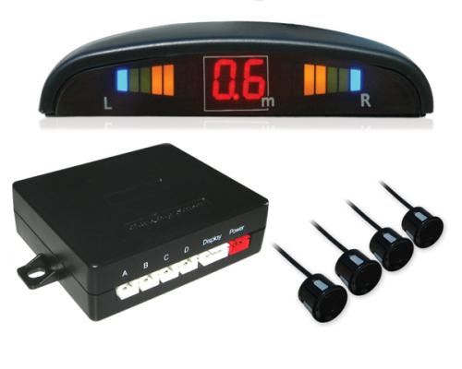
倒车雷达

Slide 16
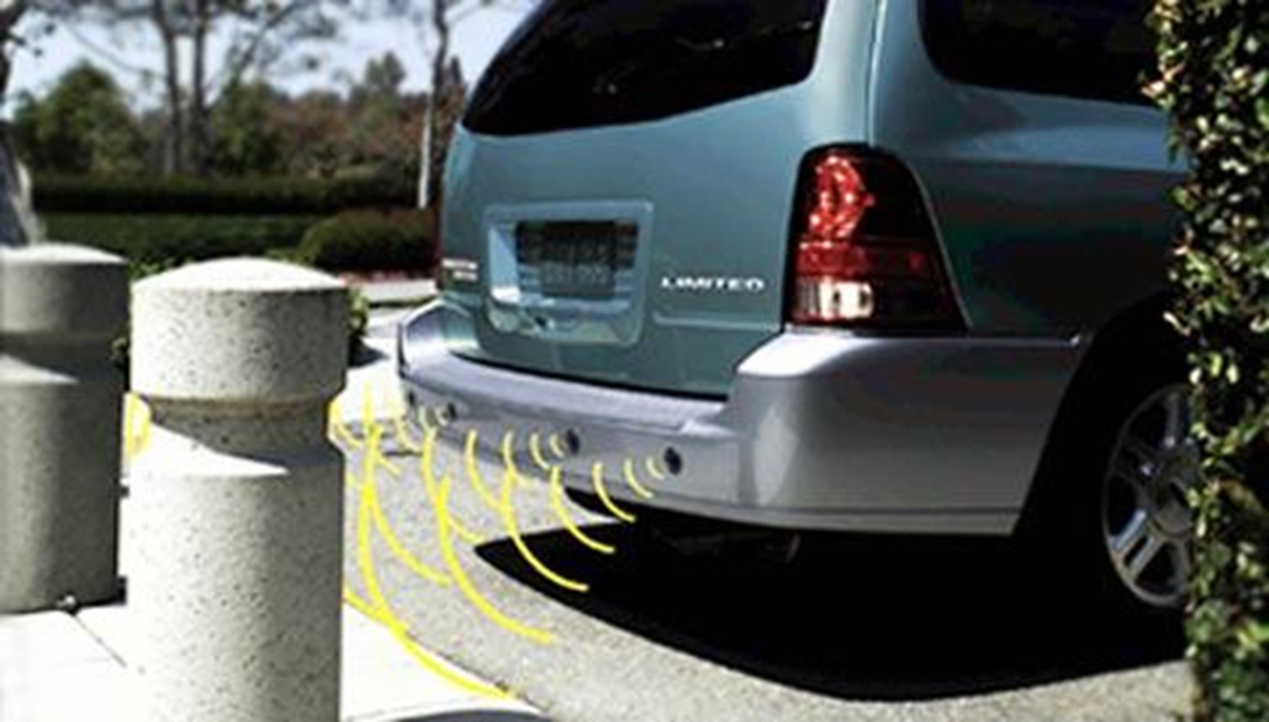
雷达发出超声波

Slide 17
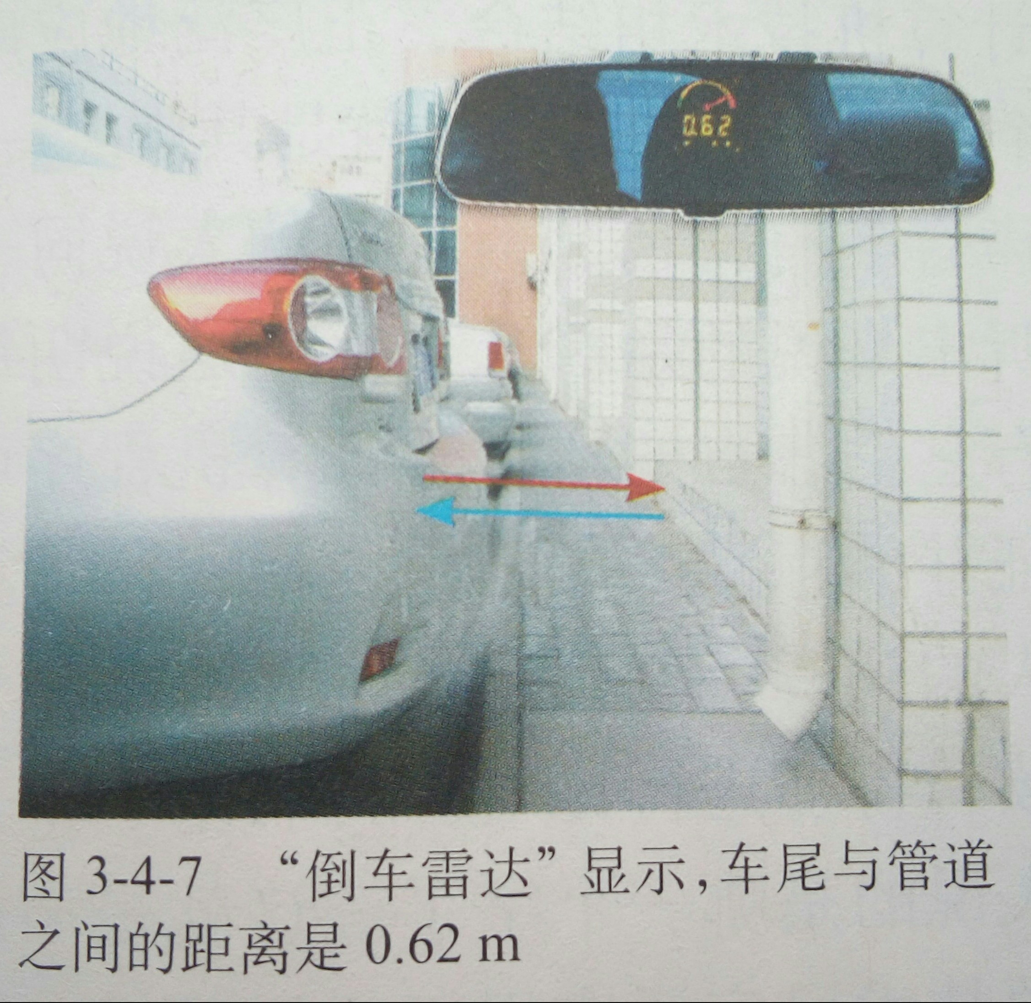

Slide 18
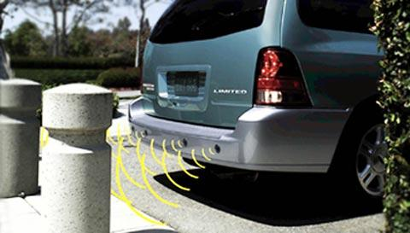
倒车雷达：传递了安全 信息

Slide 19
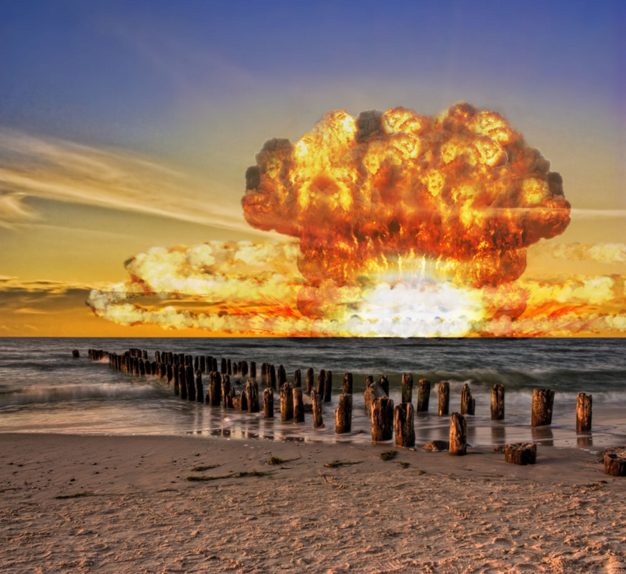
核爆炸

Slide 20

核成员国

Slide 21

全球核试验监测网

Slide 22
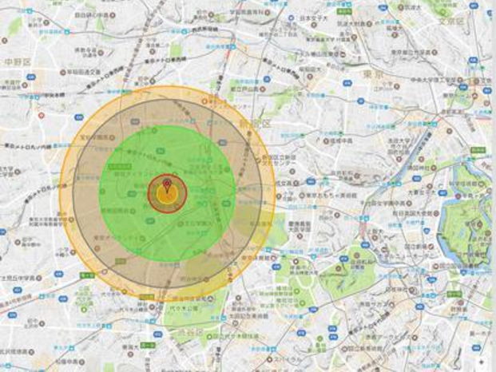
核爆炸定位

Slide 23
核爆炸
有核国家
监测网
定位
核试验监测网：传递了军事 信息

Slide 24
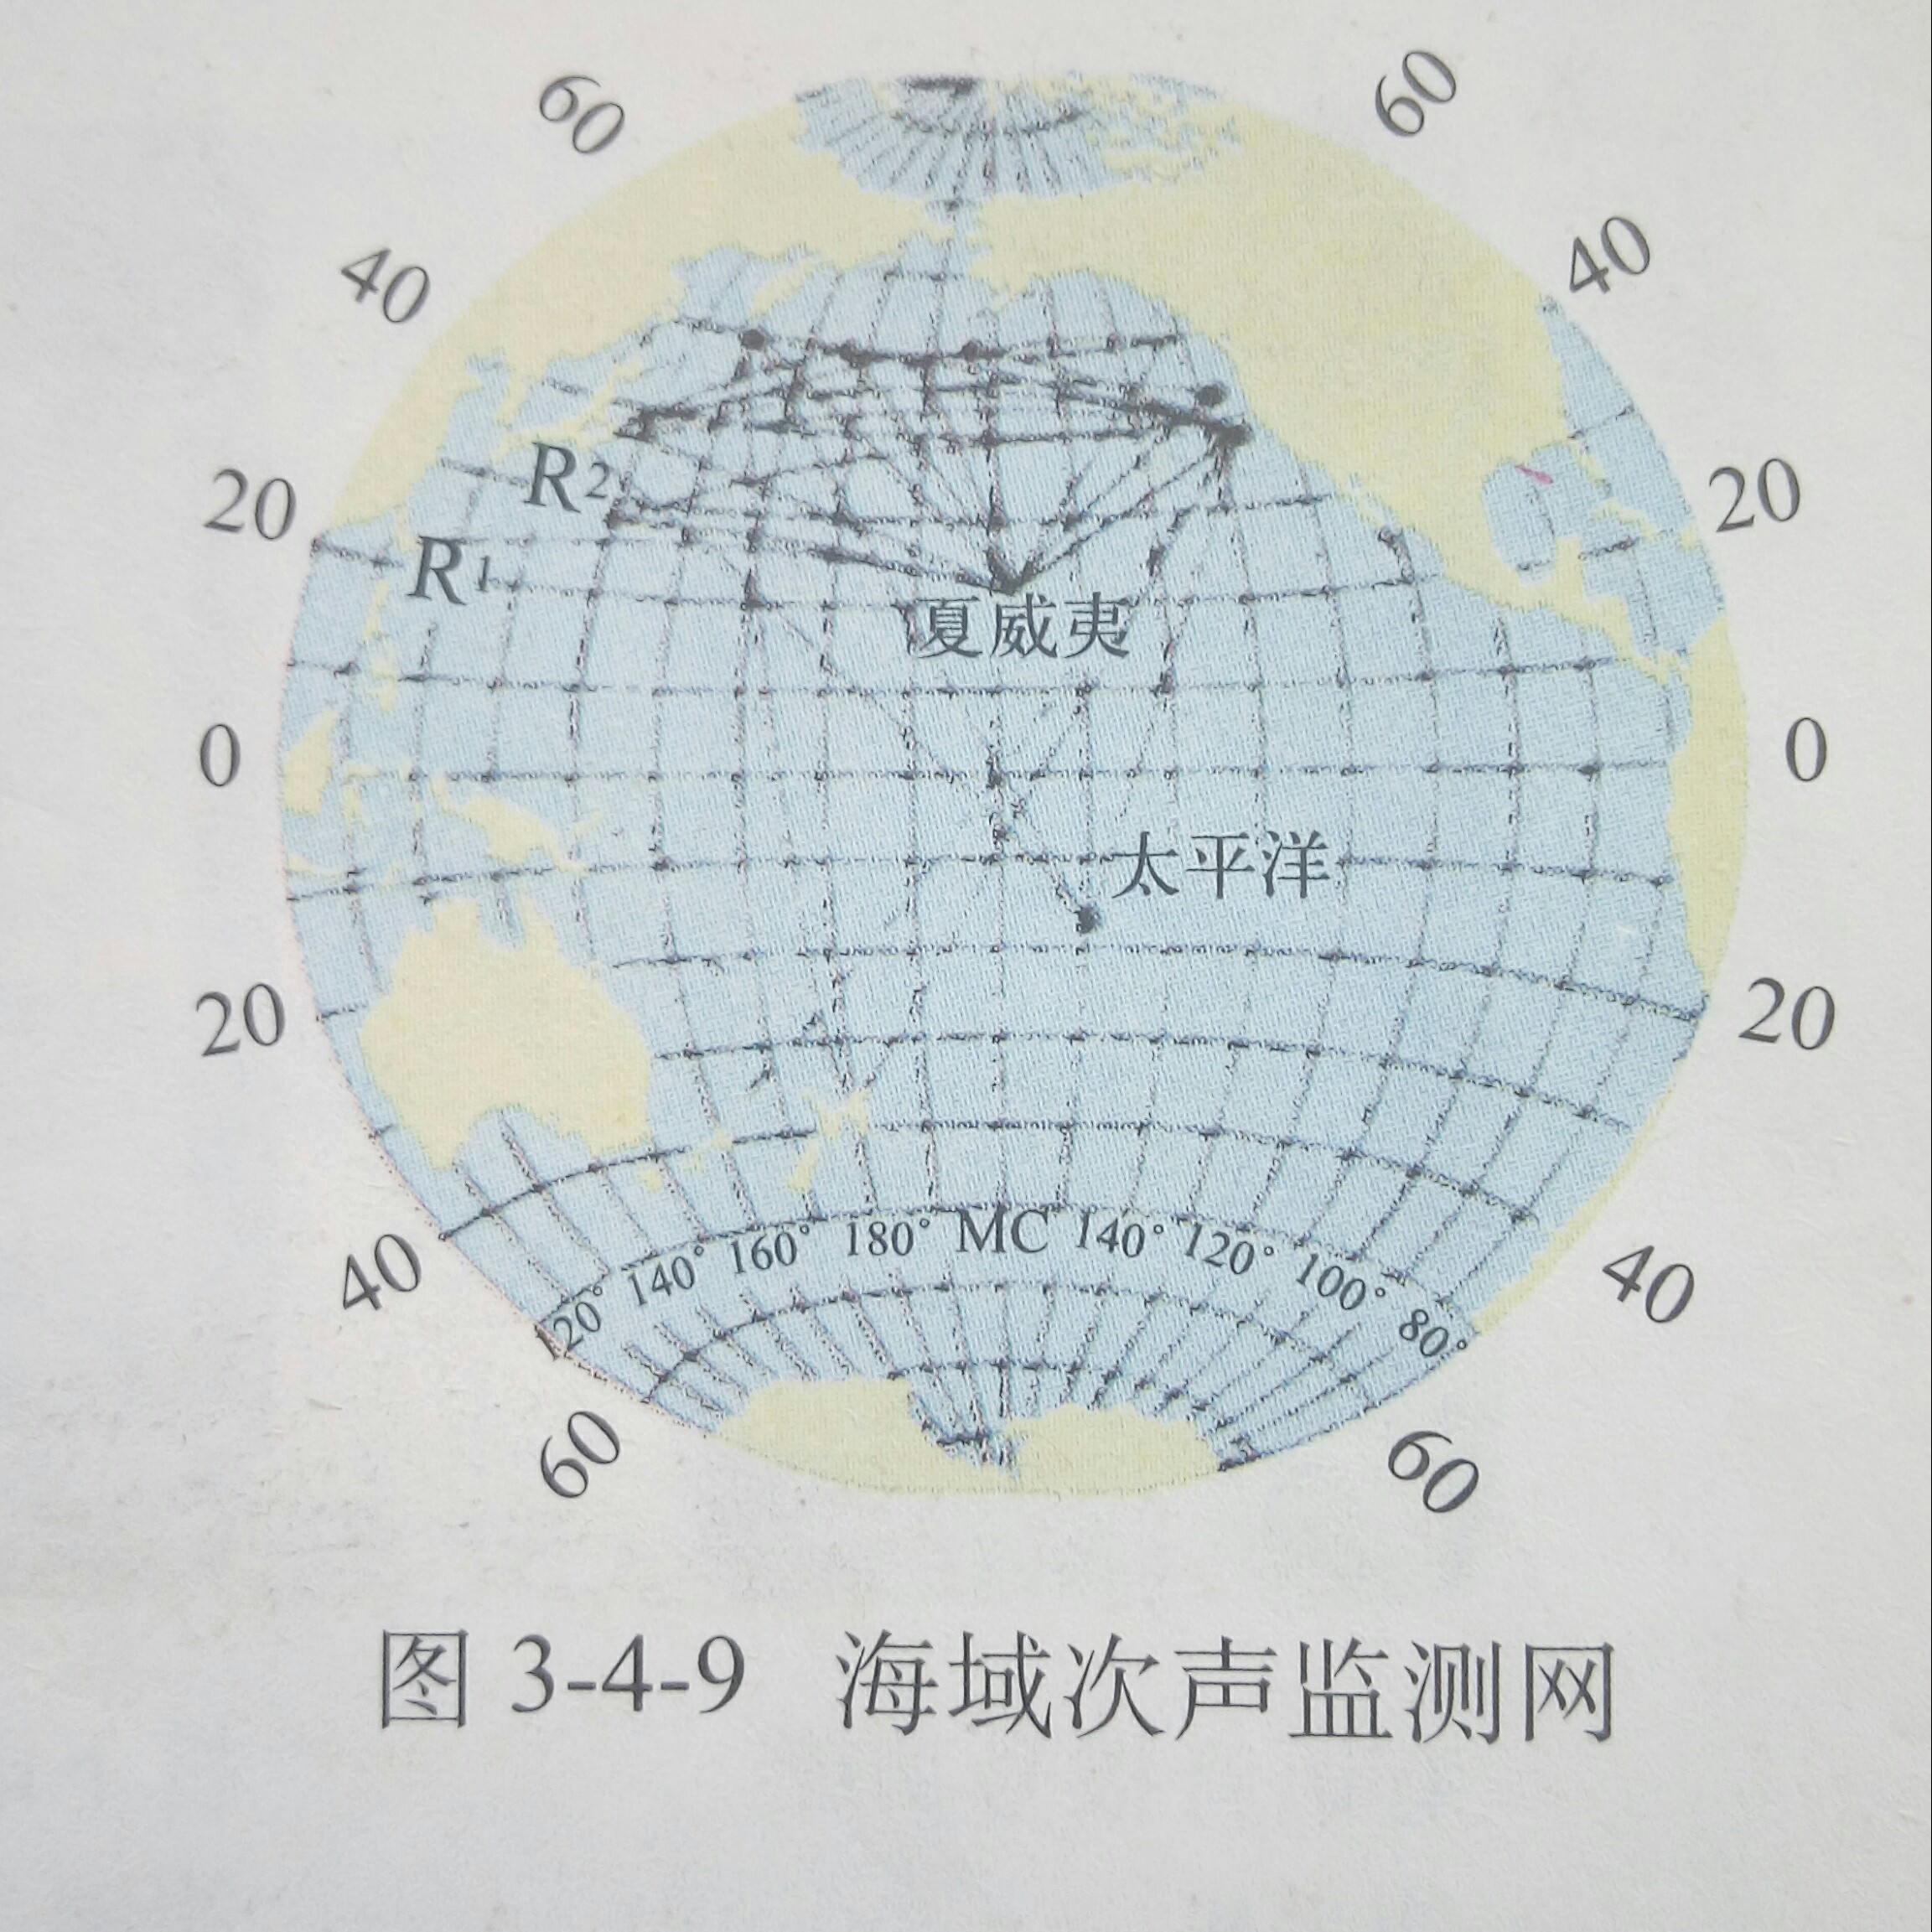
海域次声监测网：传递了
气候 信息

Slide 25
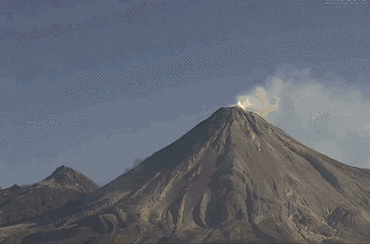
火山喷发

Slide 26

龙卷风

Slide 27
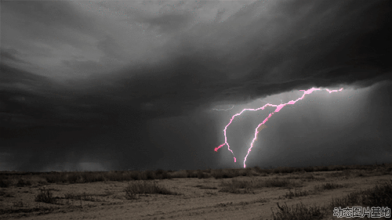
雷暴

Slide 28

泥石流

Slide 29
火山喷发
龙卷风
雷 暴
泥石流
火山喷发、龙卷风、雷暴、泥石流发生前产生的次声波，传递了灾害 信息

Slide 30
声音可以传递
能量

Slide 31

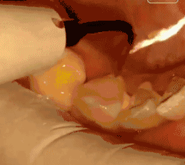

Slide 32
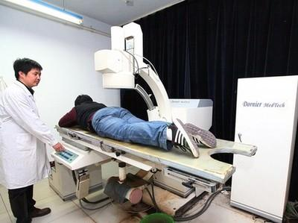
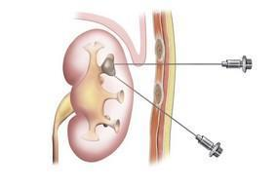
超声波碎石

Slide 33
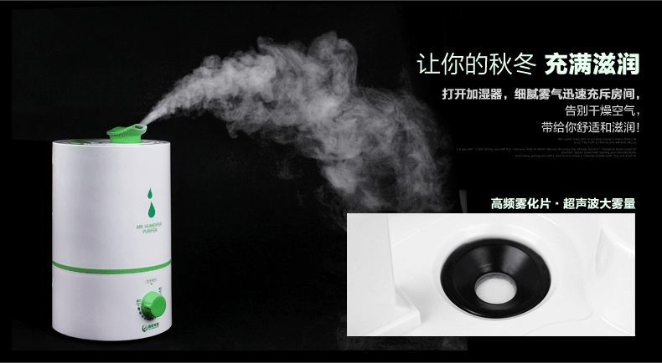
超声波加湿器

Slide 34

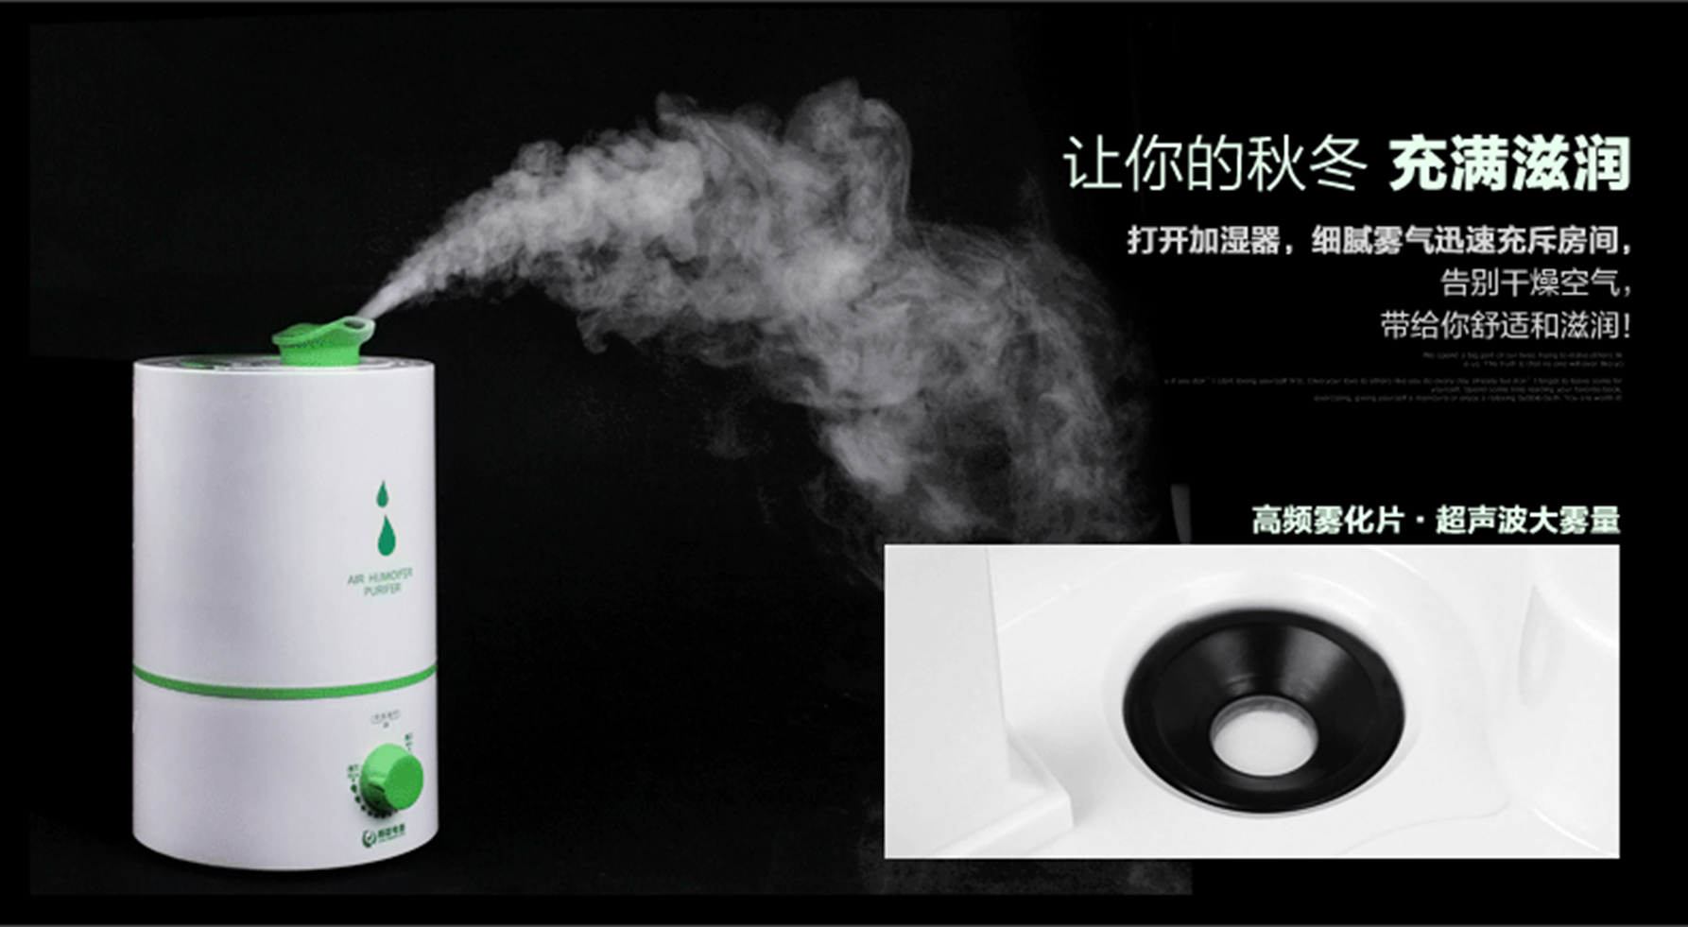
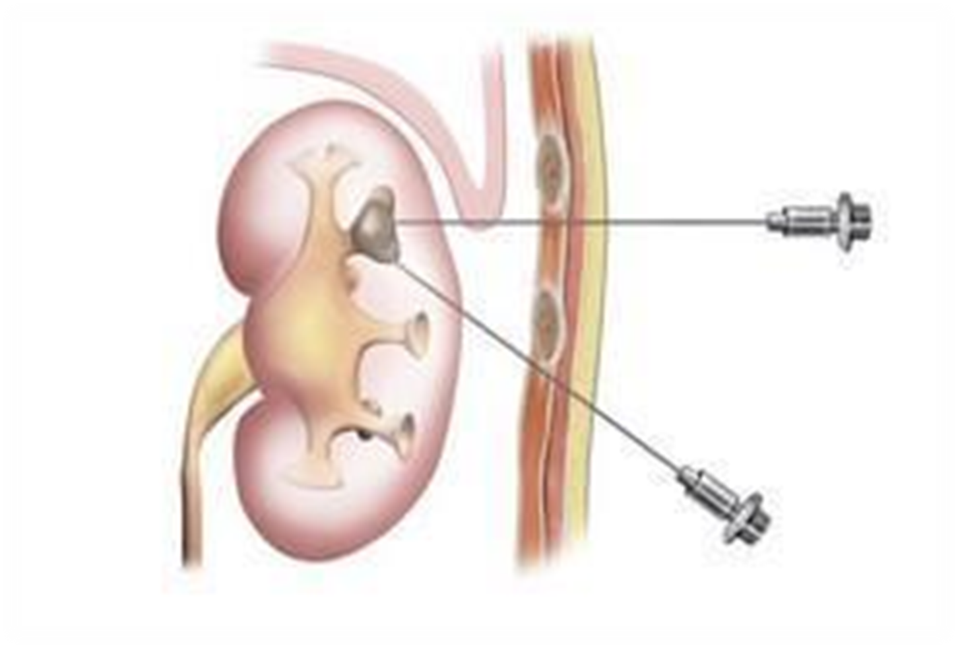
声 音 传 递 能 量

Slide 35
声音传递 信息
学到了什么？
声音传递 能量

